Slide 1
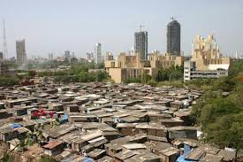
Mumbai’s housing conundrum
Sunali Rohra
Former co-leader of McKinsey’s urban practice &
Co-founder, Urban Institute of India
July 2018

Slide 2
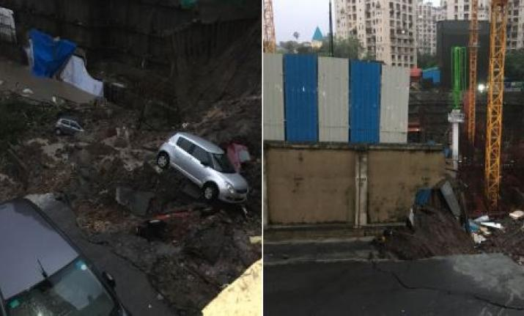
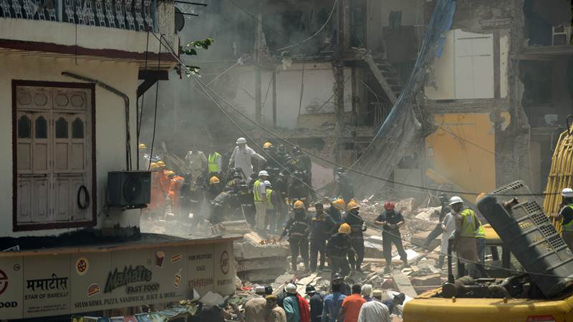
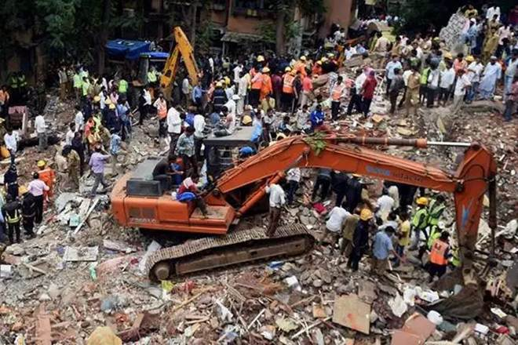
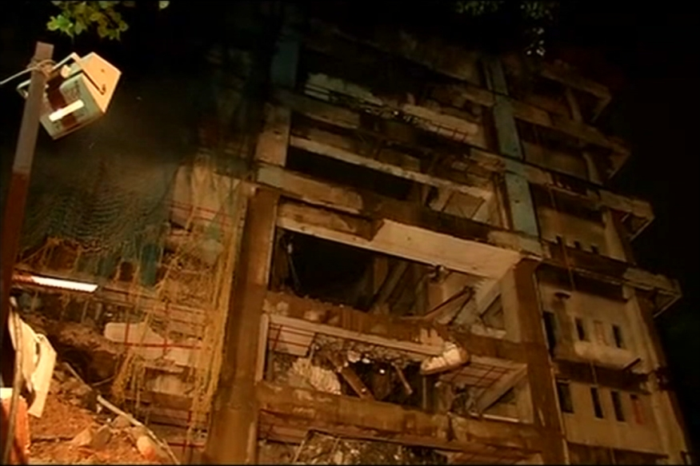
More than 600 deaths due to building collapses in Mumbai from 2001–2015
Antop Hill, June 2018
Bhendi Bazaar, September 2017
Ghatkopar, September 2017
Saiki Naka, Andheri, August 2017
Source: National Crime Records Bureau

Slide 3
In 2025, Mumbai city will account for 1.9% of Indian HHs and 5.9% of the nation’s GDP
2012, %
2025, %
Strugglers (INR <180K)
2
0
Aspirers (INR 180K – INR 485K)
53
22
Consumers (INR 480K – INR 1700k)
36
62
Globals (>INR 1700K)
8
15
Total no of Households (million)
2.96
6.04
India, total no. of HH
252.7
552.5
Source: India’s Economic Geography in 2025: States, Clusters and Cities, McKinsey & Company, 2014

Slide 4
Mumbai ranks 16 in global housing prices
How many square meters of prime property can USD 1 million buy globally
Mumbai ‘s HPI increased by 32 points between March 2014 – 18 making it 1/10 cities that saw housing prices jump over 30 points. 52% (350K) of residential inventory unsold in August 2017
Source: Knight & Frank Wealth Report, 2018, Cushman & Wakefield and Propstack, 2017
Notes:
This is about 990 square feet in Mumbai as compared to 1485 square feet in Dubai, and 300 square feet in London

Slide 5
Affordability is one of the biggest challenges and the state has done little to alleviate housing shortage
2014
1995–2014
41.9% of the city’s population lives in slums
  9/21 wards more than 50% of the population lives in slums
57% of HHs live in a one bedroom dwelling
An average of 10, 526 units constructed per year
Of the 4.6 housing units approved for construction by the Slum Rehabilitation Authority only 155,020 units received occupation certificates
480,000 houses are vacant in Greater Mumbai
Source: Praja Foundation, The state of affordable housing in Mumbai, November 2014; Economic Survey, 2017-18

Slide 6
In 2015, the central and state government have undertaken a series of measures to augment affordable housing supply
Highlights
Launch of Pradhan Mantri Awas Yojana, 2015 with a goal to build 1.1 million houses in MMR
  Stamp duty reduced to 1-3% for EWS/LIG/MIG houses + nominal registration fee
  Interest subsidy for loans upto INR 6 lakhs
  Higher FSI for affordable housing projects – 2.5 FSI in lieu of 50% of affordable housing stock creation, concession in development charges, and subsidy of INR 2.5 lakhs per flat
  Establishment of MHADA as the special planning authority to aid provision of basic infrastructure
  PPP models–provision of leased land at nominal prices to builders to construct houses to be sold at predetermined rates
Reforms to building plan approvals: new 8–step process through a single window mechanism (37 steps/128.5 days)
  Common GIS platform with details of all NOCs and approvals required from the center and state
  Property card extract time compressed to 1 day from 17 days
  Random zonal approval system
  Joint site inspection system to be introduced to issue IOD within 15 days and full cycle to be completed within 2 months
Continued focus on cluster redevelopment scheme
Source: Literature search

Slide 7
Challenges across 3 key areas explain the affordable housing crises (1/2)
Key area
Highlights
Land market distortions
Governments are the largest land owners, e.g.
  Mumbai Port Trust owns 752 acres of land in prime South Mumbai
  Railway Land Development Authority has identified 40 acres of land across prime locations like Bandra, Lokmanya Terminus and Mahalaxmi
  62 army cantonments account for 2.3 lakh acres of land
Archaic laws: Urban Land Ceiling Act repealed but large tracts of land in dispute with no redressal system in place. Maharashtra Rent Control Act, 1999 has resulted in a significant decline in rental housing stock
Absence of a well functioning system of land records
Short duration for land leases: Lease tenure for most government–owned lands reduced to 35 years
Weak governance
Fractured governance: 17 city agencies govern Mumbai with lack of effective coordination
Legislative vacuum: Housing is a state not “city” subject – 74th Constitutional Amendment remains silent on housing as a function
  Three state agencies tasked with fixing housing in Mumbai
    Slum Rehabilitation Authority,
    MMRDA
    MHADA
Source: literature search, analysis

Slide 8
Challenges across 3 key areas explain the affordable housing crises (2/2)
Key area
Highlights
Weak governance
Inadequate institutional capacity: City structures lack the capacity to organize affordable housing units into a society for effective maintenance.
  For example, in London, the council is responsible for facilitating the O&M for the housing stock
Weak contract enforcement: Housing is a hugely political issue in Mumbai (slum structures and inhabitants residing in those areas prior to 1st January 2000 are eligible for rehabilitation). Shortage of 5000 judges across districts led to 20.8 million pending cases across India in 2016
Haphazard urban planning
Absence of transit oriented planning required to open up the hinterlands and augment land supply. 520 sqkm of land required for housing by 2032
  Vacancy rate of houses in Thane and Raigad is higher compared to the island city because of poor connectivity
Lack of a cohesive economic master plan to specifically develop mini–regions
Absence of effective multi-modal integration across the railways, buses, rickshaws and IPT: Large cities typically have a Unified Metropolitan Transport Authority, e.g. Transport for London
Absence of cost and quality standards: Benchmarks help prevent leakages through varied construction costs for the same locality

Slide 9
A 15–point programme to fix Mumbai/India’s affordable housing conundrum requires fully embodying the spirit of “cooperative federalism” (1/2)
Key area
Reforms
Bolster governance
Revise the 74th Constitutional Amendment to include housing as a city subject
Create the institutional framework for housing at the city level including reforms to existing institutions like the Slum Rehabilitation Authority
  Brazil set up the “My House, My Life” programme that constituted establishment of a USD 20 billion fund; provided affordable finance to citizens (5% to 8% interest rates) and 40% lower to developers; and incentives to suppliers
Build city and state capacity (elected and executive) for effective governance
Strengthen citizen participation at the ward/council level through Citizen Councils
Amend the Maharashtra Rent Control Act, 1999
Move to a system of a directly elected metropolitan mayor
Fix land market distortions (1/2)
Establish SPVs to develop Government owned lands, e.g. MPT lands alone can contribute 1.5–2MM housing units
Expeditiously digitize land records and make them easily accessible under the National Land Records Modernization Programme
Levy vacant land tax to curtail creation of land banks as done by Andhra Pradesh, and Tamil Nadu based on the minimum and maximum prices set up the state government. 3% levied in Latin America

Slide 10
A 15–point programme to fix Mumbai/India’s affordable housing conundrum requires fully embodying the spirit of “cooperative federalism” (2/2)
Key area
Reforms
Fix land market distortions (2/2)
Create fast track courts to address all pending cases resulting from archaic rules and regulations
Collaborate with Government of India to extend leasehold periods for 99 years
Create an effective land pooling policy for development of public infrastructure in congested areas, e.g. Zaveri Bazaar
Planning and Delivery
Create the institutional capacity to create Local Area Plans given their efficacy. MCGM states it does not have the capacity to create LAPs that have been dropped from the Mumbai DP 2014–2034
Capacity to efficiently execute the DP 2034: Ensure delivery of the basic infrastructure required to support the development of 1 million additional affordable housing units
Effectively execute the new 8–step online process for building plan approvals

Slide 11
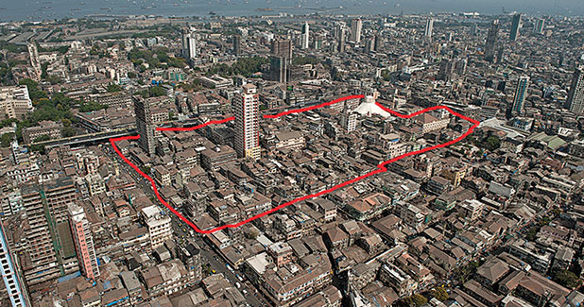
A first–of–its–kind community–led redevelopment: Bhendi Bazaar
Project scope
Community–led redevelopment approach
Saifee Buhrani Upliftment Trust (SBUT) established in 2009 specifically for this cluster redevelopment
Capitalised with USD 650MM through loans and donations.
  80% of land area to be used for rehabilitation of tenants.
  3 sale towers on residual land to recover costs
Borrows two key features of Singapore’s model for AH
  Focus on the importance of neighborhoods and mixed use inclusive and sustainable developments, e.g. Gold Rating by Indian Green Building Council, each cluster to have its own sewerage treatment plant to recycle 100% of sewerage generated
  Smart use of urban density to provide for sustainable development e.g. rain water harvesting, green and recreational areas, intelligent parking (3000 parking spaces planned)
Transit housing provided to tenants in collaboration with the state
  Consent obtained from 70% of building owners; 100 buildings demolished
  First set of tenants to return in September 2019
Key issues
  Lack of effective regulations
  Pass through of increased carpet area of 35 sqft.
  Reluctance of tenants to relocate due to social and commercial reasons, e.g. proximity to schools, mosques
  Uncertainty around completion dates
One of the busiest areas in Mumbai
80% of the 250 buildings spread across 16.5 acres
declared “Dilapidated and Dangerous”
Inhabited by 3200 families and 1250 businesses
Impacting 20,000 people
Based on the new cluster redevelopment policy
Source: CBUTH, Research Paper, Ambitious Mumbai Project, 2015, New York Conference

Slide 12
Thank You!

