Slide 1
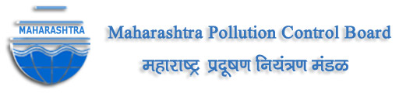
Championing Smart and Sustainable Solid Waste Management in MMR
Landfill Waste Pollution and Control
09.01.2020

Slide 2
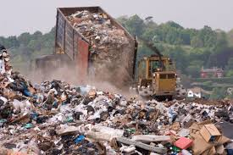
Environmental Impacts of landfills
1. Air Pollution
Decomposition of household solid waste releases methane gas. As a potent greenhouse gas, methane traps up to 20 times more heat in the atmosphere compared with carbon dioxide
Air surrounding landfill sites smells unpleasant, due to the decaying organic waste.
2. Biodiversity Impacts
Local species of animals, with mammals and birds replaced by species that feed on refuse- rats & crows.
Local plant species affected

Slide 3
Environmental Impacts of landfills
3. Groundwater Pollution
As rain falls on landfill sites, organic and inorganic constituents dissolve, forming highly toxic chemicals leaching into groundwater.
Water that rinses through these chemicals collects at the base of the landfill and usually contains high levels of toxic metals, ammonia, toxic organic compounds and pathogens.
This can result in serious contamination of the local groundwater. Even more dangers, this mixture usually creates a high biological oxygen demand, meaning it can quickly de-oxygenate water.

Slide 4
Environmental Impacts of landfills
4. Soil Fertility Effects
Mixture of toxic substances and decaying organic material can impact the soil quality of the areas surrounding a landfill site.
This can compound the effects on biodiversity as local vegetation may cease to grow and be permanently altered.
5. Visual and Health Impacts
Impact on natural landscape: they stink, they are trashy looking and a become a bacteria breeding ground. The smell, traffic, noise and vermin that accompany landfills can lower house prices

Slide 5
Environmental Acts / Rules related with Waste Management
The Hazardous & Other Wastes (M&TM) Rules, 2016.
The Solid Waste Management Rules, 2016 .
The E-Waste (Management) Rules, 2016 .
The Plastic Waste Management Rules 2016.
The Construction and Demolition Waste Management Rules, 2016.
The Bio-Medical Waste Management Rules, 2016

Slide 6
Regulations related to waste
Solid waste and plastic waste in India regulated by Solid Waste Management Rules, 2016 and Plastic Waste Management Rules, 2016
Responsibilities of each stakeholder such as generator, local bodies, Urban local bodies, plastic producers etc. is well-defined in these rules
Solid waste- Duties are being fixed on waste generators to segregate waste at source in three bin system bio degradable, non-bio degradable & domestic hazardous waste.
Plastic waste- Extended Producer Responsibility on the plastic producers/ brand owners for management of their plastic waste introduced

Slide 7
Salient Features of Solid Waste Management Rules, 2016:
Landfill
Recovery
Recycling
Reuse
Reduction
Prevention
Waste hierarchy is defined i.e. priority order in which the solid waste is to should be managed such that,
prevention → most preferred option
disposal at the landfill → least preferred option

Slide 8
Salient Features of Solid Waste Management Rules, 2016 wrt landfilling
Urban Development Authorities→ While preparing State policy and strategy on solid waste management, follow waste hierarchy to ensure minimisation of waste going to the landfill and minimise impact of solid waste on human health and environment;
Local Authorities →
  Stop land filling or dumping of mixed waste after timeline specified for setting up and operationalization of sanitary landfill is over
  Allow only non-usable, non-recyclable, non-biodegradable, non-combustible and non-reactive inert waste and pre-processing rejects and residues from waste processing facilities to go to sanitary landfill and the sanitary landfill sites shall meet the specifications

Slide 9
Salient Features of Solid Waste Management Rules, 2016 wrt landfilling
The Rules have specified specifications for sanitary landfills
Criteria for site selection, facilities at the site, operation of landfills and scientific closure
Criteria for pollution prevention, water quality and ambient air quality monitoring

Slide 10
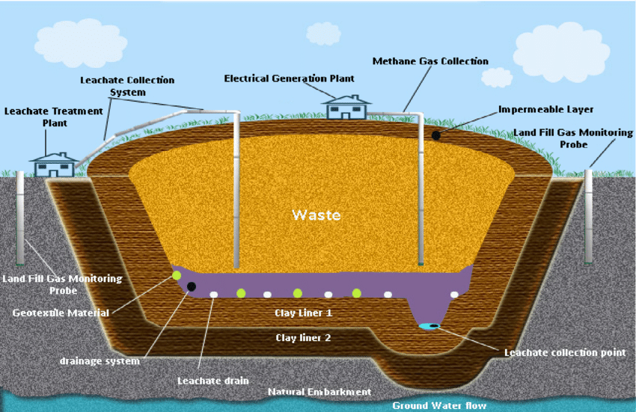
Sanitary Landfills
Sanitary landfills are sites where waste is isolated from the environment until it is safe.
It is considered when it has completely degraded biologically, chemically and physically.
• Full or partial hydrogeological isolation
• Formal engineering preparations
• Permanent control
• Planned waste emplacement and covering

Slide 11
CPCB guidelines for disposal of Legacy waste
Guidelines published by CPCB in February 2019
Treatment & disposal can be done by-
  Bio-remediation
  Bio-mining
Excavation of old dumped waste and make windrow of legacy waste, thereafter stabilization of waste through bio-remediation
Screening of stabilized waste to recover valuable resources (organic fines, bricks, plastic, metal, cloth etc.)
Costs for operation and maintenance→ 400-700 Rs/ m3 onsite (capital cost extra)

Slide 12
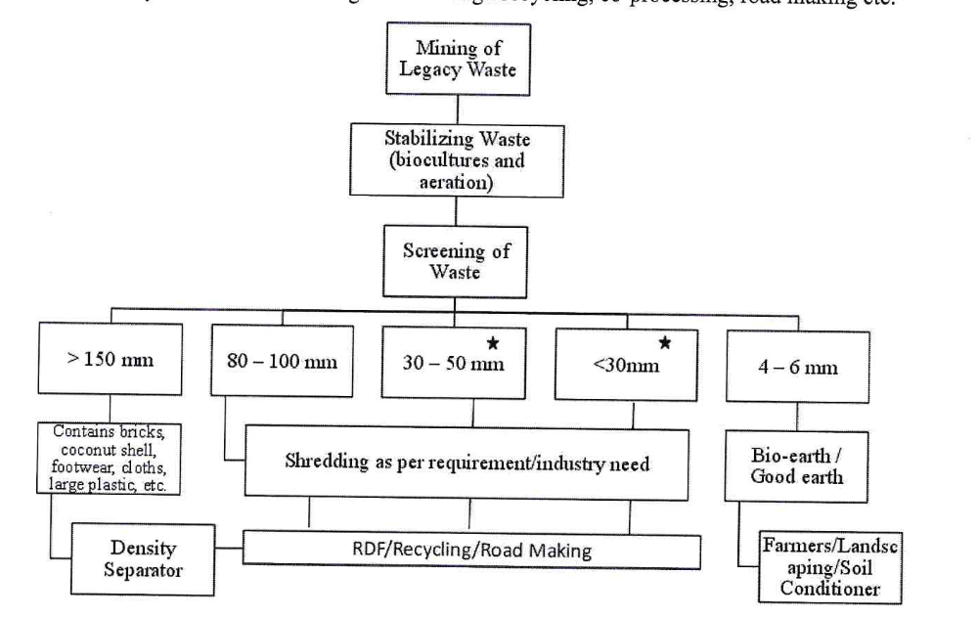
CPCB guidelines for disposal of Legacy waste

Slide 13
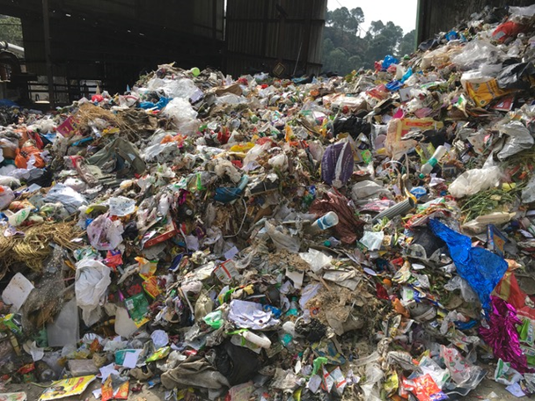
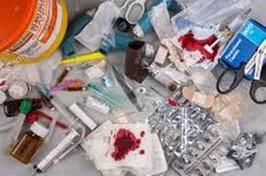
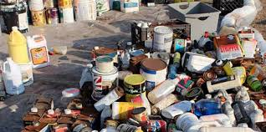
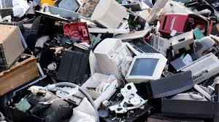
Waste Quantification In India
62 million tonnes of waste is generated annually in the country
5.6 million tonnes is plastic waste,
0.17 million tonnes is biomedical waste,
hazardous waste generation is 7.90 million tonnes per annum and
15 lakh tonnes is e-waste.

Slide 14
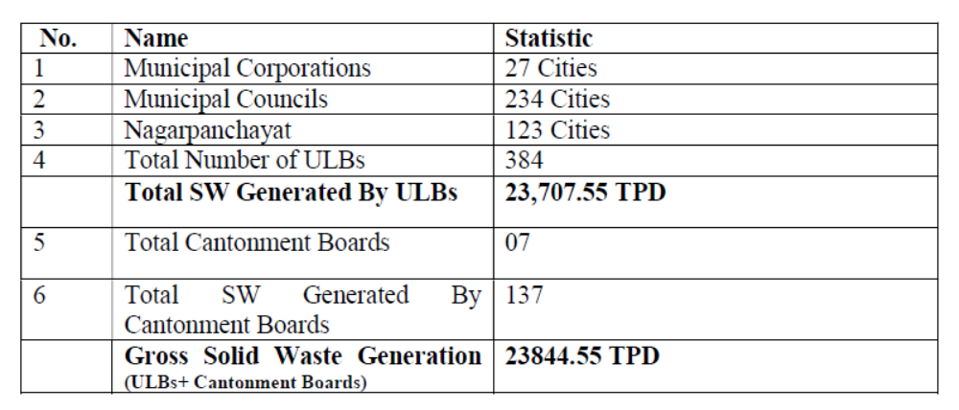
Maharashtra State Solid Waste Management Status
86.5 lakh tonnes per year
Waste generated (MT/day) | Total Waste Collected (MT/D) | Total Waste Scientifically Treated (MT/D)
23707.55 | 23,540 (99%) | 12571 (53%)
40.6 lakh tonnes per year going to landfill/ dumps

Slide 15
Plastic generation in Maharashtra
Around 4 lakh tonnes/ annum plastic waste generated in Urban Local Bodies (ULBs) of Maharashtra
Out of this almost 88% plastic waste is collected, whereas 55% is channelized for recycling/use
Currently, Maharashtra has around 165 consent granted recyclers (capacity= 4.43 lakh TPA), out of which 31 recyclers (capacity= 1,23,338 TPA) have obtained registration under PWM Rules 2016 from MPCB.

Slide 16
Average Composition (%w/w) of MSW in India
Moisture content may vary from 30 to 70 depending on season
Bioderadables 40-45
Paper , card boards etc. 8-11
Plastics/rubber 5-7
Metals Around 1
Glass 0.8-0.9
Rags around 1
Inerts 15-20
This shows substantial variation season and location wise

Slide 17
MSW Treatment Options
MSW
Organic
Bio-degradable
Organic
Non-Bio-degradable
(Combustibles)
Recyclables
Including C&D waste
Inerts
Bio-chemical Route
Composting
  Vermi
  Windrow
  in-vessel
Bio-methanation
Energy and Resource
Thermal Route
incineration
  Mass Burning
  RDF
Pyrolysis ( R & D stage)
Gasification ( Not commercialized)
Energy
Reuse/ Recycle
Sanitary Landfill

Slide 18
Application of Technology- Indian Conditions Capacity Limitations
S.No. | Technology | Suitable scale | Advantages | limitations
1 | Composting | Up to 300 TPD | Simplicity, capital cost, product value | Large processing times and space, local utility of the product
2. | Bio-methanation | Less than 100 TPD | Biogas, and manure, smaller size, energy | Complex, sensitive, capital intensive, scale up problems, biogas purification
3. | Incineration | Minimum 300 TPD | Small size, matured design and engineering, energy, complete solution, easy scale up | Complex, capital intensive, Ash utilization

Slide 19
Share of MMR in Maharashtra’s MSW & Plastic waste generation
MPCB regions namely Kalyan, Mumbai, Navi Mumbai, Raigad, Thane under MMR region
MMR region has 40% population of Urban Local Bodies in Maharashtra.
But, it contributes to around 53% in MSW generation
Additionally, MMR contributes to 58% of plastic waste generation, but lags behind in collection (44% share) and recycling (49% share)

Slide 21
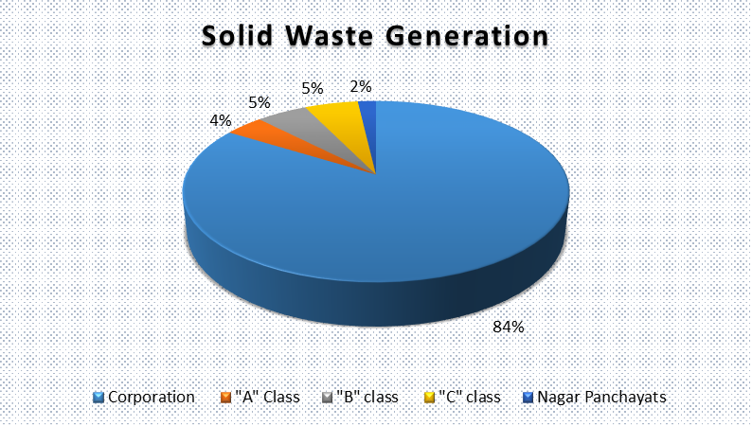
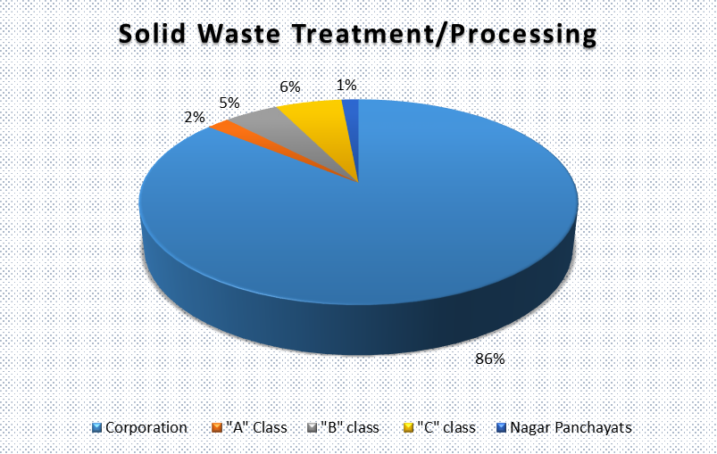
Solid waste generation and treatment in 2018

Slide 22
Waste segregation & Legacy waste in MMR
Details | Districts
 | Mumbai | Thane | Raigad
Total solid waste Generation (MT/day) | 6500 | 3869 | 548
Qty. of Dry Waste segregated | 140 | 1415 | 220
Qty. of Wet Waste segregated | 5200 | 2030 | 322
Qty. of C&D Waste segregated | 800 | 289 | 9
Qty stored in dumpsites | 70 Lakh MT | 263076 | 27176
No of Old dump sites | 1 (Mulund) | 5 | 8
No of Sanitary landfills | 1 (Kanjurmarg, 300 Ton/day) | 3 | 10

Slide 23
Challenges in Municipal Solid Waste Management
Absence of Segregation of Waste at Source.
Lack of Funds with ULBs for Waste Management
Available Funds are not Utilized in Efficient Manner.
Lack of Technical Expertise and Appropriate Institutional Arrangement.
Lack of Serious Efforts of ULBs to Introduce Proper Collection, Segregation, Transportation and Treatment / Disposal Systems Perhaps because of incurring Expenses in O&M.
Unwillingness of ULBs to Charge SWM Charges.
Indifference of Citizens towards Waste Management due to Lack of Awareness.
Lack of Community Participation towards Waste Management and Hygienic Conditions
Lack of Proper Planning .

Slide 24
Initiatives taken by MPC Board:
Board has issued directions for 25 % budgetary provision for each year for the management of municipal solid waste and management & treatment of sewage, by passing specific Resolution in the General Body and Standing Committee Meeting of such Local Body, in order to sensitize the Corporators / Members of the Local Body.
Accordingly 26 Municipal Corporations out of 26 Municipal Corporations have complied with the directions by submitting resolution passed by the Local Bodies.
Board has also formed a committee for scrutiny of authorisation and the treatment technology prepared by Local Body and also to suggest/guide them.

Slide 25
Initiatives taken by MPC Board:
Maharashtra Pollution Control Board has decided to provide financial and technical assistance to local bodies for setting up wastewater treatment centers and solid waste management facilities.
Circular has been issued by the Board to all concerned officers on 25.10.2019.
The local body is required to submit a detailed project report (DPR).
Assistance of up to Rs. 2 lakh will be provided by the Board to the DDR for making DPR.

Slide 26
Initiatives taken by MPC Board:
The standard of assistance to local self-government organizations-
  A class municipality – 2.5 Rs. Cr
  B Class Municipality - 2.0 Rs. Cr
  A Class Municipality - 1.5 Rs. Cr
The assistance will be in the form of interest free loan for 3 years and will be provided to the organizations in installments below -
  30% - After the plan is approved
  30% - 50% of the plan is implemented
  30% - After the scheme is started
  Remaining 10% - After successful work and maintenance of the scheme

Slide 27
Initiatives taken by MPC Board:
DPR prepared for all 384 ULBs by UDD for SWM management and have earmarked 2584 Rs. Cr. on the MPCB directions
Legacy waste which is MSW dumped since last many years
  2.38 lakh tons legacy waste is present in Maharashtra
  Mumbai and Pune Regions with highest quantity of legacy waste
  Processing of legacy waste sites has started in Mumbai & Pune

Slide 28
Positive Implications of Plastic Rules, 2016 and MH Plastic Notification, 2018
These 2 regulations have helped to improve plastic waste management in the state, thereby reducing plastic waste going into the land fill sites
As of now, almost 406 plastic industries have been issued closure directions by MPCB due to non-compliance with 2018 Notification
Fine of Rs. 6.25 Cr collected in joint action with urban local bodies; banned plastic items of around 1200 tonnes seized from shops & plastic industries
Most of the EPR are planned to be implemented through PROs due to lack of experience of plastic industries in plastic waste management
PRO’s collection centers at different locations in Maharashtra

Slide 29
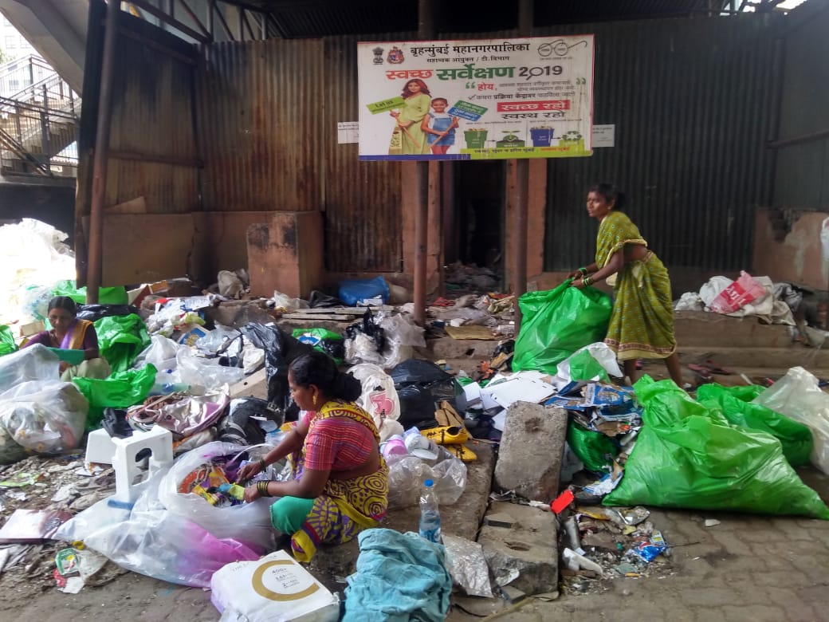
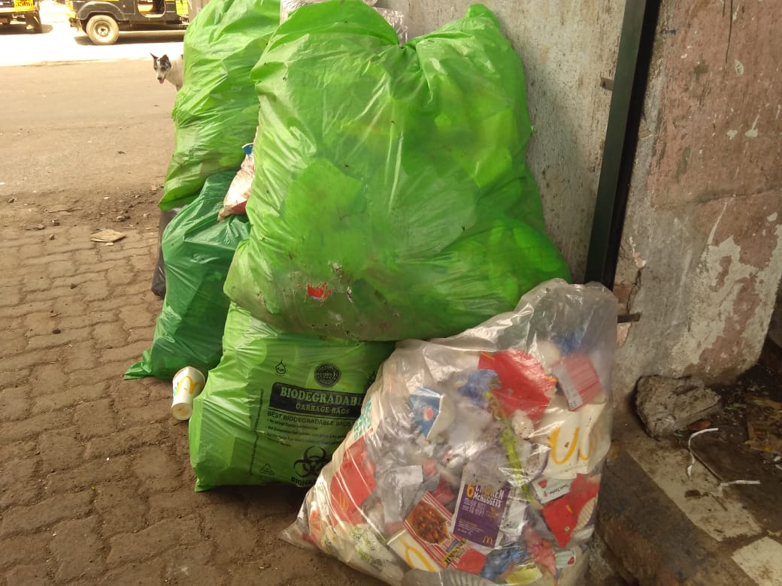
Positive Implications (contd.)
MPCB has conducted physical verification of the collection centers in Mumbai, Pune & Aurangabad area
Regular monitoring of collection and disposal mechanism

Slide 30
Plastic waste recycling in Maharashtra
The plastic recyclers convert the plastic waste into plastic granules or flakes or fuels for further reuse in manufacturing of plastic products
The installed capacity of 24 plastic recyclers registered with MPCB= 1,16,381 Tonnes per annum as of September 2019.
Recycled plastic quantity through these recyclers in year FY 2017-18 was 8,850 Tonnes, whereas 27,463 Tonnes were recycled in FY 2018-19.
PROs, which are working for EPR implementation of plastic producers, have collected and processed almost 27,000 tonnes of plastic
  13500 tonnes for recycling of plastic
  12400 tonnes as fuel in cement factories.

Slide 31
E-Waste Management in Maharashtra
Maharashtra generates almost 20% of India’s E-waste
Majority is generated in MMR due to higher economic activities
E-Waste scenario in FY 2018-19
  E-Waste Producers- 261
  E-Waste Recyclers- 7
  Total Capacity allotted to recyclers- 17400 MT/A
  E-Waste Recycled- 1995 MT
  E-Waste Dismantlers- 49
  Total Capacity allotted to dismantlers- 50520 MT/A
  E-Waste Dismantled- 5036 MT

Slide 32
Bio-medical waste (BMW) in Maharashtra
Maharashtra generates almost 71.5 tonnes of BMW/day
Total no. of Health Care Facilities / Occupiers= 63,824
Total No. of beds= 2,93,345
Installation of Continuous Online Emission Monitoring System with CBWTF- out of 28, 25 have installed it
Out of 30 Common Treatment Facilities (CTF), 17 CTFs have started Barcode system, others are in process and being followed up.
All CTFs have GPS enabled Vehicle Tracking

Slide 33
Thank You…

Slide 34
MSW generation in MMR region in Maharashtra
MSW | Kalyan | Mumbai | Navi Mumbai | Raigad | Thane | Total MMR | Share of MMR ULBs in Maharashtra's ULBs
MSW Generation (Ton/year) | 617,606 | 2,810,500 | 259,515 | 209,685 | 719,360 | 4,616,666 | 53%
MSW Treated (Ton/year) | 96,725 | 1,608,555 | 256,960 | 197,940 | 186,369 | 2,346,549 | 51%
% treatment | 16% | 57% | 99% | 94% | 26% | 51%

Slide 35
Plastic generation in MMR region in Maharashtra
Plastic | Kalyan | Mumbai | Navi Mumbai | Raigad | Thane | Total MMR | Share of MMR ULBs in Maharashtra's ULBs
Plastic waste generated (TPA) | 58,133 | 98,550 | 9,608 | 6,685 | 23,251 | 196,227 | 58%
Plastic waste collected (TPA) | 50,825 | 9,855 | 9,596 | 6,672 | 23,205 | 100,153 | 44%
% collection | 87% | 10% | 100% | 100% | 100% | 51%
Plastic waste channelized for recycling (TPA) | 29,785 | 9,855 | 9,308 | 4,527 | 5,683 | 59,158 | 49%
% recycling (of generation) | 51% | 10% | 97% | 68% | 24% | 30%

